Slide 1
Employee Data Analysis using Excel
STUDENT NAME: RAMYA R
REGISTER NO: 312210988/ asunm143312210988
DEPARTMENT: DEPARTMENT OF COMMERCE [B.COM(ACCOUNTING AND FINANCE)]
COLLEGE : DR MGR JANAKI COLLEGE OF ARTS AND SCIENCE FOR WOMEN

Slide 2
PROJECT TITLE
Employee Performance Analysis using Excel

Slide 3


AGENDA
Problem Statement
Project Overview
End Users
Our Solution and Proposition
Dataset Description
Modelling Approach
Results and Discussion
Conclusion
3/21/2024 Annual Review

Slide 4

PROBLEM STATEMENT
1.IDENTIFYING STRENGTHS AND WEAKNESSES: Understand individual skills and areas for improvement.
2. SETTING GOALS AND EXPECTATIONS: Establish clear objectives and targets.
3. EVALUATING JOB FIT: Determine if employees are suited for their roles.
4. DEVELOPMENT AND GROWTH: Create training plans and opportunities for advancement.
5. PERFORMANCE IMPROVEMENT: Address underperformance and provide support.
6. FAIR COMPENSATION AND REWARDS: Base salary and benefits on performance
7. SUCCESSION PLANNING: Identify future leaders and key players.
8. ENHANCING EMPLOYEE ENGAGEMENT: Recognize and value contributions.
9. STRATEGIC DECISION-MAKING: Inform business decisions with data-driven insights.
REGULAR ANALYSIS HELPS EMPLOYEES GROW, IMPROVES ORGANIZATIONAL
EFFICIENCY, AND DRIVES BUSINESS SUCCESS

Slide 5

PROJECT OVERVIEW
The Employee Performance Analysis project aims to enhance employee
performance and business success through data-driven insights. The project will
collect relevant data, establish clear performance metrics, conduct statistical
analysis, and present findings and recommendations to stakeholders. The scope
includes identifying strengths, weaknesses, opportunities, and threats, and
implementing actions to address performance gaps, develop training programs, and
enhance employee engagement. The project will deliver a comprehensive analysis
report, actionable recommendations, customized training plans, and an enhanced
performance evaluation framework. With a timeline of [insert timeline], the project
will involve HR, management, department heads, and employees, and will benefit
the organization through data-driven decision-making, improved employee
engagement and productivity, and increased business efficiency and success.

Slide 6

WHO ARE THE END USERS?
❑EMPLOYER
❑EMPLOYEE
❑ ORGANISATION
❑ IT SECTORS
❑ BUSINESS FIRM
❑ COMPANY

Slide 7
OUR SOLUTION AND ITS VALUE PROPOSITION
CONDITIONAL FORMATTING:IT IS USED TO FIND OUT THE
BLANK VALUES.
FILTERING: IT IS USED TO FILTER OUT THE BLANK VALUES
FROM THE DATA.
PIVOT TABLE: PIVOT TABLE IS USED TO SUMMARIZES,
ORGNAIZES AND ANALYZES THE DATA IN A TABLE.
CHART: A CHART IS USED TO VISUALLY REPRESENT THE
DATA AND HELP US TO SEE PATTERNS AND TRENDS IN OUR data

Slide 8
Dataset Description
❖ EMPLOYEE DATA SET – KAGGLE
❖ 26 FEATURE
❖ FEATURE- 9 FEATURE
❖ EMPLOYEE ID- CATEGORICAL DATA
❖ GENDER-MALE,FEMALE
❖ PERFORMANCE LEVEL-ORDINAL DATA
❖ BUSINESS UNIT-REFERENCE DATA SET
❖ NAME-NOMINAL DATA
❖ RATING-NUMERICAL VALUE

Slide 9

THE "WOW" IN OUR SOLUTION
• CONDITIONAL FORMATTING:BY USING THIS
BLANK CELLS WERE FOUND AND HIGHLIGHTED.
• FILTER: BY USING THIS FILTER THE BLANK VALUES
WERE REMOVED.
• FORMULA USED TO IDENTIFY PERFORMANCE
LEVEL: IFS
EG : = IFS(Z8>=5,“VERY
HIGH”,Z8>=4,“HIGH”,Z8>=3,“MEDIUM”,TRUE,“LOW”)
3/21/2024 Annual Review
9

Slide 10
MODELLING
DATA COLLECTION: KAGGLE WAS THE SOURCE WHICH WAS USED TO COLLECT DATA.ALMOST 26 FEATURE WAS
COLLECTED AND 9 FEATURES WERE USED IN EXCEL.
SOME OF THE FEATURE WAS EMPLOYEE ID,FIRST NAME,CREDIT RATING.
DATA CLEANING: THE COLLECTED DATA WAS CLEANED AND FILTERED USING CONDITIONAL FORMATTING AND
FILTER .
TECHNIQUES:
• CONDITIONAL FORMATTING:BY USING THIS BLANK CELLS WERE FOUND AND HIGHLIGHTED.
• FiLTER: BY USING THIS FILTER THE BLANK VALUES WERE REMOVED.
RESULTS: THE RESULT WAS CALCULATED ON THE BASIS OF PERFORMANCE OF THE EMPLOYEE
PIVOT TABLE:THE PIVOT TABLE WAS DONE USING THE FOLLOWING:-
✓ FILTER:GENDER CODE
✓ COLUMNS:PERFORMANCE LEVEL
✓ ROWS:BUSINESS UNIT
✓ VALUES:COUNT OF FIRST NAMES.
CHART:THE CHART CHOOSEN FOR THE ABOVE DATA IS BAR GRAPH
BY USING TREND LINE ,THE LINEAR WAS SET AT VERY HIGH VALUE AND EXPONENTIAL WAS SET UP AT LOW VALUE
10

Slide 11
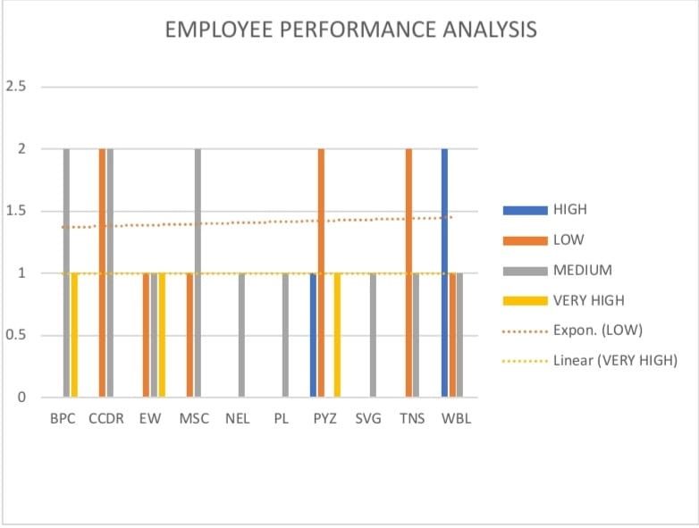
RESULTS
11

Slide 12
conclusion
In conclusion, the Employee Performance Analysis project has provided valuable insights into the strengths, weaknesses, opportunities, and threats within our organization. By analyzing
employee performance data, we have identified areas for improvement, optimized performance Metris, and developed targeted training and development programs. This project will empower the organization to make data-driven decisions, enhance employee engagement and productivity, and drive business growth. Ultimately, this project has set a new standard for employee performance management, positioning the organization for continued excellence and competitiveness in the industry

